Slide 1
Racket Project
Amir Kallel
Suresh Dharani Parasuraman
Alexander Kozhinov

Slide 2
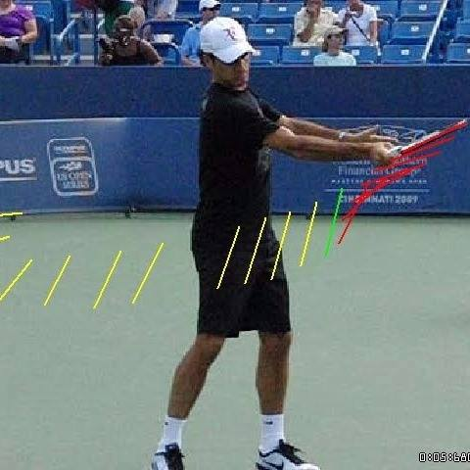
The Idea again
5/10/17
Racket Project

Slide 3
Outline
Modeeling the perfect tennis swing
IMU embedded in the racket
Live data plotting & fitting
5/10/17
Racket Project

Slide 4
Modeling the Perfect Tennis Swing
20 Tennis swing motions performed seperately with LG smart watch worn on wrist.
Sensor data recorded individually using Cmotion:
Acceleration
Magnetic Field
Gyroscope
9 data set [3 axis per sensor] analyzed and plotted using Matlab
5/10/17
Racket Project

Slide 5
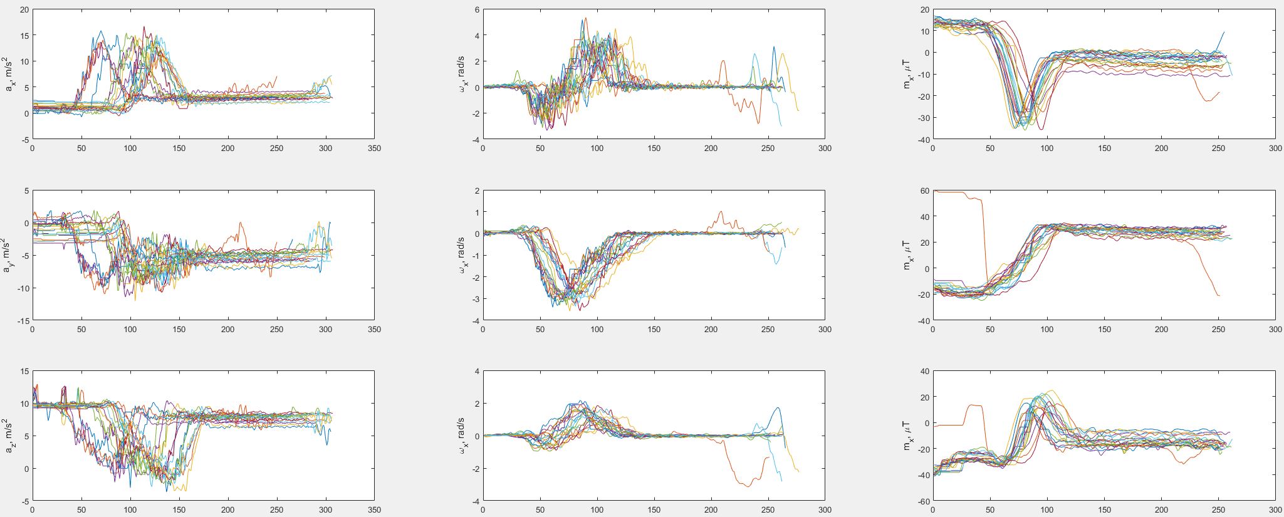
Modeling the Perfect Tennis Swing
However, 20 data swings have different time stamps
5/10/17
Racket Project

Slide 6
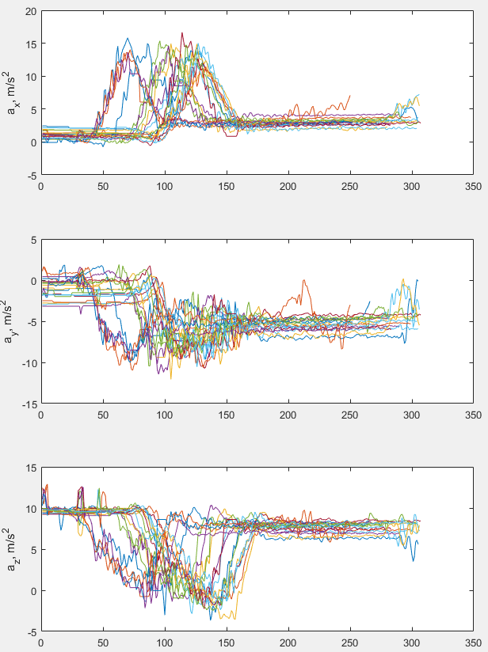
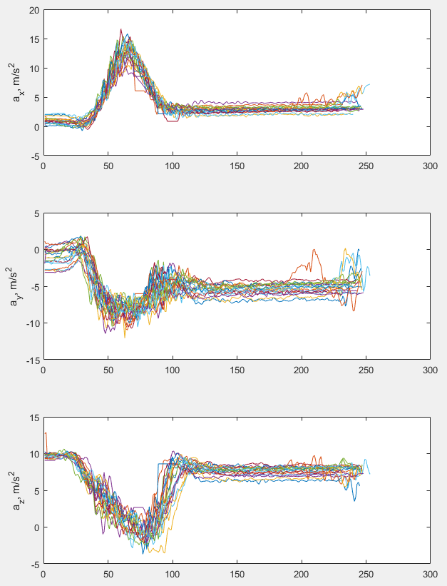
Modeling the Perfect Tennis Swing
Acceleration X-axis time shift example
5/10/17
Racket Project

Slide 7
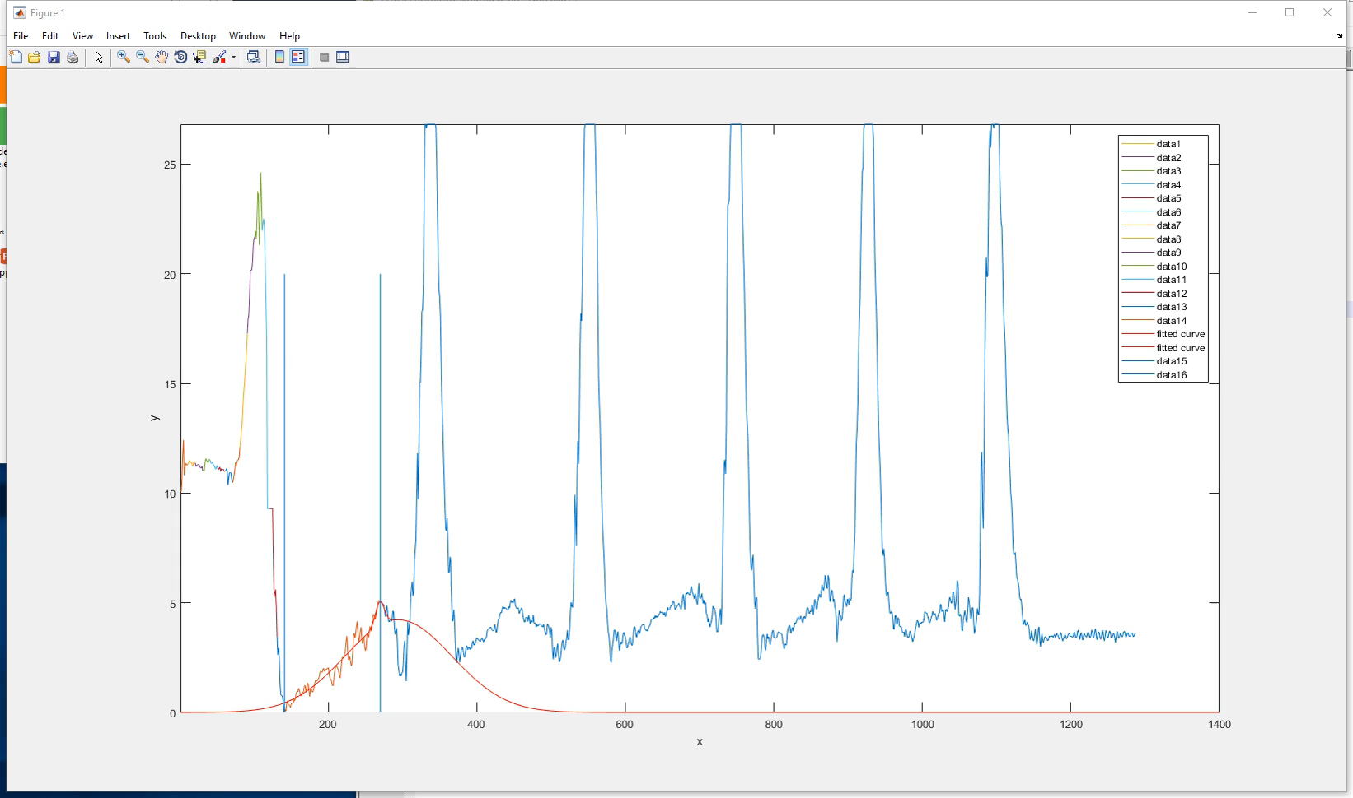
Modeling the Perfect Tennis Swing
Ídentifying the most suitable fit type
through dynamic Matlab script
Trial & error
5/10/17
Racket Project

Slide 8
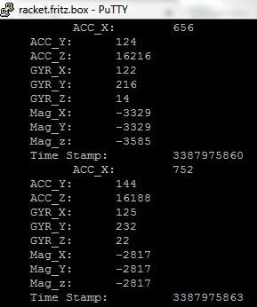
IMU embedded in the racket
Using an MPU9150 IMU
The same 3 sensor data aquisition with predefined timestamp
C++ app
TO DO:
UDP data transmission
5/10/17
Racket Project

Slide 9
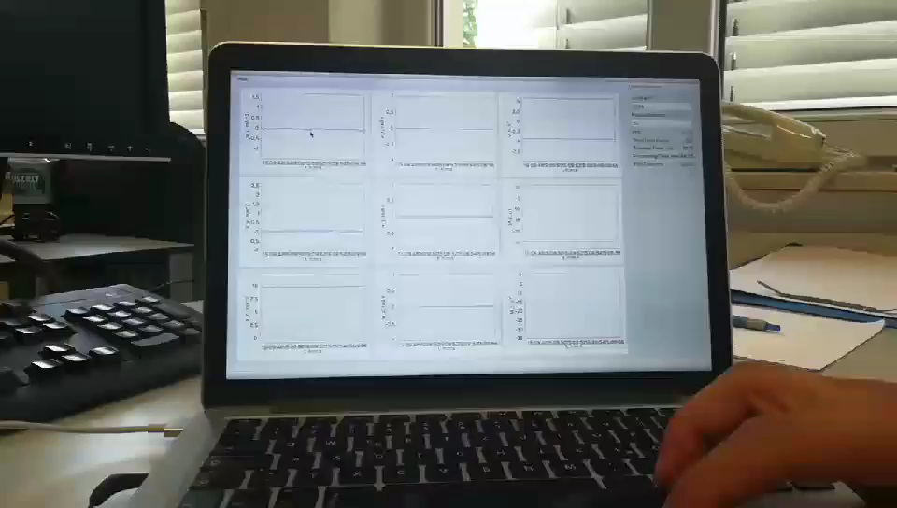
Live data plotting & fitting
C++ app reading live stream sensor data over UDP [sent from smartphone]
Low response time for visualisation
5/10/17
Racket Project

Slide 10
IMU embedded in the racket
Using an MPU9150 IMU
The same 3 sensor data aquisition with predefined timestamp
C++ app
TO DO:
UDP data transmission
5/10/17
Racket Project

Slide 11

Q & A
5/10/17
Racket Project

